Slide 1
Cs3420 project

Slide 2
Team Organization & Members
Team members: Rick, O’Brian, Joe, and Garrett
Democratic team organization. Each member is equally responsible for the project.

Slide 3
Project Language
Project will be developed using the C++ language
Qt will be used for GUI

Slide 4
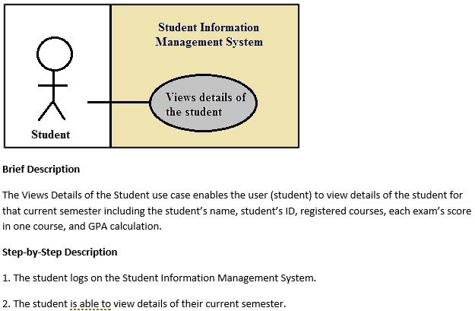
Student Use Case
Enables student to view name, ID, classes, exam scores, and GPA
The student will log onto the system
Will then be able to view the details of the current semester.

Slide 5
Student Use Case

Slide 6
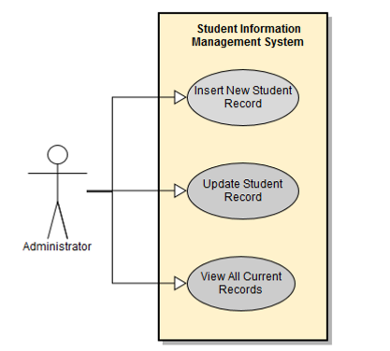
Administrator Use Cases
Enables the administrator to insert and update new student record as well as view all current records of student

Slide 7
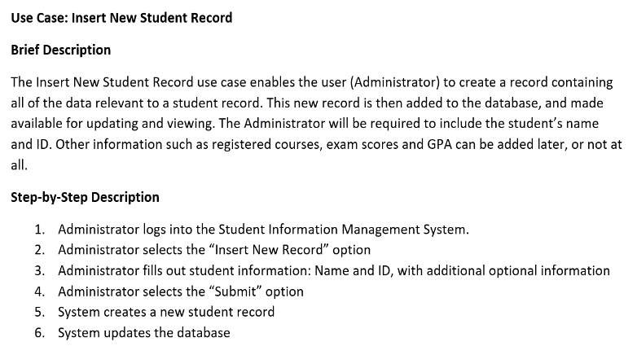
Administrator Use Cases

Slide 8
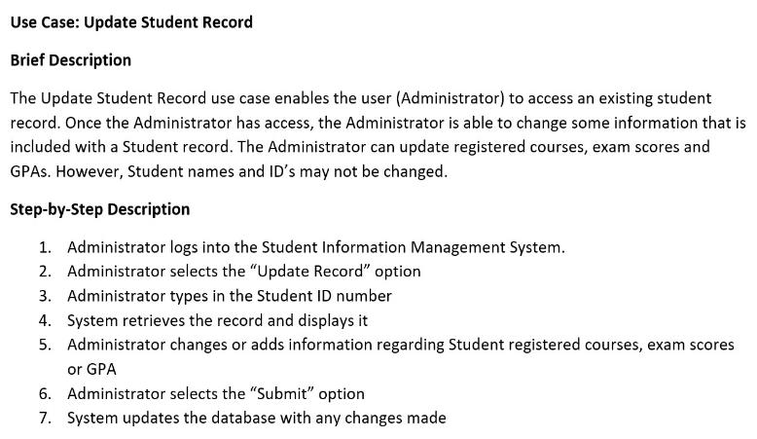
Administrator Use Cases

Slide 9
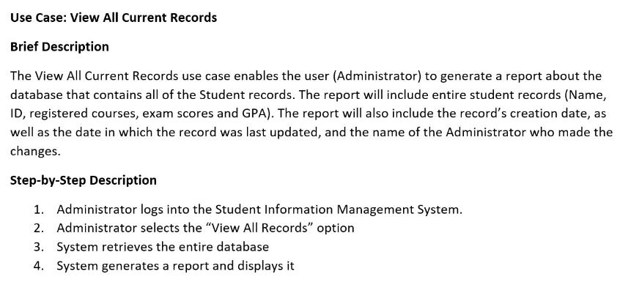
Administrator Use Cases

Slide 10
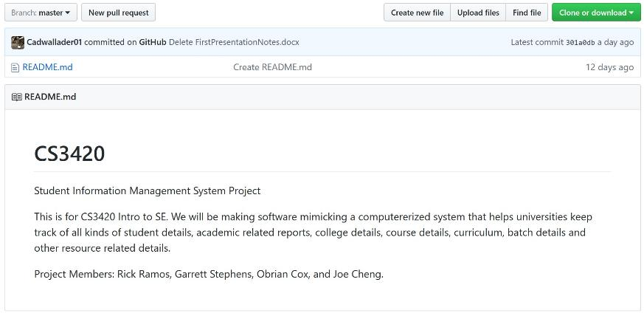
GitHub Account
https://github.com/Cadwallader01/CS3420

